Slide 1
Design Patterns

Slide 2
Categories
Creational patterns provide object creation mechanisms that increase flexibility and reuse of existing code.
Structural patterns explain how to assemble objects and classes into larger structures, while keeping these structures flexible and efficient.
Behavioural patterns take care of effective communication and the assignment of responsibilities between objects.

Slide 3
Creational Patterns
Factory Method - provides an interface for creating object(s) of a single type in a superclass, but allows subclasses to alter the type of object that will be created. It uses inheritance and relies on a subclass to handle the desired object instantiation.
Abstract Factory - produce families of related objects without specifying their concrete classes. A class delegates the responsibility of object instantiation to another object via composition.
Abstract Factory classes use Factory Methods within, which then can use Prototype pattern to create objects.

Slide 4
Creational Patterns
Builder - construct complex objects step by step. Produce different types and representations of an object using the same construction code.
Prototype - copy existing objects without making your code dependent on their classes. Useful alternative to subclassing, when subclasses differ very slightly, clone the parent and then adjust few properties.
Singleton - ensure that a class has only one instance, while providing a global access point to this instance.

Slide 5
Shoe store
Formal, Casual, Sports, …
Nike, Adidas, Puma, …
Football, Running, Basketball, …
UK 5, UK 6, … UK 12, …
Blue, Green, Magenta, …
Under 2K, 2K-5K, 5K-10K, …
Notes:
In this case you can see there are 6 categories already and we can add even more, like design, versions of each shoe type, formal/casual/sports, etc. Not all categories should have their own class, some of them like (size, colour, design, etc.) can be added just as a property in the class. To decide which categories deserve their own classes, we need to ask only 1 question, whether this category would have any impact on how the shoe gets processed or are there any if/else blocks in the class methods based on this category? For example, brand name is crucial in determining the inventory management, discounting strategy, marketing medium, target customer, return policies, etc.
Basically we need to figure out the deciding factors, these will result in the if-else blocks in our code. For a shoe store, first row is more than enough.

Slide 6
Problem
How to efficiently manage inventory for each type of shoe?
How to decide on the discounting strategy?
How many classes to create?
How are they related to each other?

Slide 7
Solution
Shoe
FormalShoe
CasualShoe
SportShoe
NikeCasualShoe
NikeSportShoe
AdidasSportShoe

Slide 8
Solution
Shoe
FormalShoe
CasualShoe
SportShoe
NikeCasualShoe
NikeSportShoe
AdidasSportShoe

Slide 9
Shoe factory
Formal, Casual, Sports, …
Nike, Adidas, Puma, …
Football, Running, Basketball, …
UK 5, UK 6, … UK 12, …
Blue, Green, Magenta, …
Under 2K, 2K-5K, 5K-10K, …

Slide 10
Builder
Director
FormalShoeBuilder
CasualShoeBuilder
SportShoeBuilder

Slide 11
Automobile Factory – Assembly Line
Wheels
Engine
Body material
Doors
Windows
Gears
Headlight
…

Slide 12
Cloning
How to create copies of existing objects?
Simple way: Create a new object and manually copy every property.
Problems
Need to know the class of the object.
Can’t copy private fields.
Solution
Prototype.

Slide 13
Prototype
An object that supports cloning is called a prototype.
Different objects with common base class.
Real world analogy
Mobile factory, car designing, etc.
Several prototypes get created before finalizing final product.
These prototypes are mostly similar.
Each of them start as an exact copy of another object.

Slide 14
Global object
Problems
Control access to a shared resource
Provide secure global access
Solution
Singleton

Slide 15
Singleton
Ensures class has only a single instance.
Global access point to that instance.
Initialized only when it’s requested for the first time.
Cons
Violates the Single Responsibility Principle.
Requires special treatment in a multithreaded environment.
Difficult to write unit tests.
Notes:
2 responsibilities – ensuring single instance is created and providing global access.

Slide 16
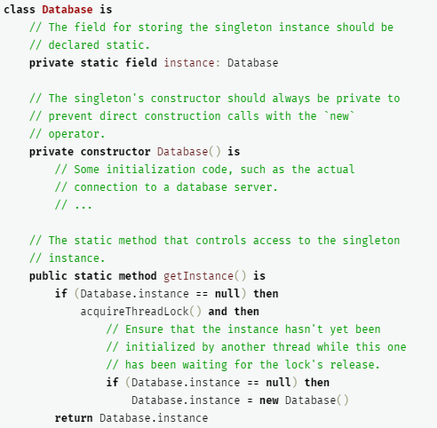
Singleton Pseudocode

Slide 17
Structural Patterns
Adapter – connecting incompatible objects
Bridge – split large class; separate abstraction and implementation
Composite – inheritance on repeat
Decorator - wrapper
Façade – simplified interface for complex set of classes
Flyweight – share common data between multiple objects
Proxy – middleware that controls access to original object

Slide 18
Behavioural Patterns
Chain of Responsibility – divide a task into series of sub-tasks
Command – UI is independent of backend
Iterator – abstract traversal of a collection
Mediator
Memento
Observer
State
Strategy
Template Method
Visitor

